Slide 1
Scaling Laws for Transfer
By Danny Hernandez, Jared Kaplan, Tom Henighan, Sam McCandlish
Presented by Balaji Balasubramanian and Eshwanth Baskaran

Slide 2
Index
What are scaling laws?
What is transfer learning?
What are scaling laws for transfer?
Experiment 1: Transfer from English to Python programming language
Experiment 2: Transfer from English to other human languages
Conclusion

Slide 3
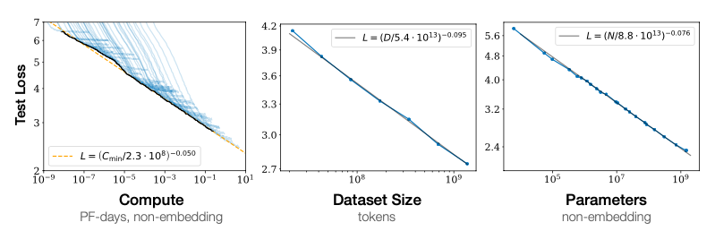
What are scaling laws?
The Language Model’s performance increases smoothly as we increase the amount of compute used for training, dataset size and the model size.
In each of the three graphs below, one of the three metrics is fixed and the others can be freely varied to obtain the best performance.
Kaplan et al. - Scaling Laws for Neural Language Models

Slide 4
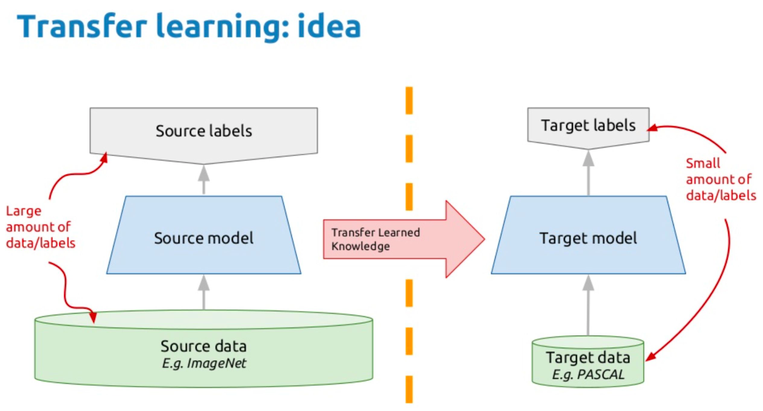
What is transfer learning?
Transfer the knowledge gained in one task to use it in another task.
In deep learning, use a pre-trained network and apply it to a custom task.
Useful in cases where the labelled data is very less.
https://www.pinterest.com/pin/424745808604824736/

Slide 5
What are scaling laws for transfer?
Most of the work in scaling assumes the availability of infinite amount of data.
But most real world problems have limited availability of data.
This paper focuses on benefits of transfer learning for low data regime and scaling law equations for quantifying the benefits.

Slide 6
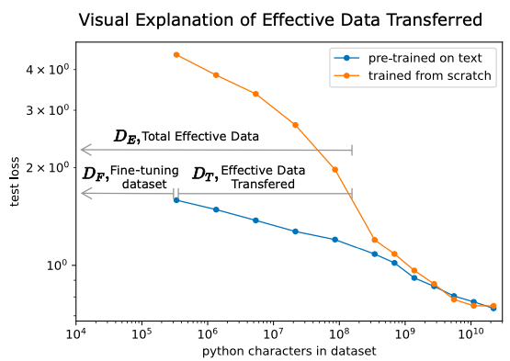
Experiment 1: Transfer from English to Python language
Explores transfer learning for a model pretrained on English text and finetuned on python code.
This was compared to the model that was trained from scratch on Python.

Slide 7
Effective Data Transfer
Effective Data Transfer is useful for measuring the importance of pretraining
This graph shows the performance of a 40M parameter model
Blue- model pretrained on text and finetuned on python.
Orange- model trained from scratch on python.

Slide 8
Effective Data Transfer
D_{F} - Finetuning Dataset size (in characters)
D_{E} - Total effective data the model trained from scratch requires to reach the same performance.
D_{T} (Effective Data Transferred) = D_{E}-D_{F}

Slide 9
Effective Data Transfer
For a 40M parameter Transformer model finetuned on 3e5 characters, D_{E} is approximately 1000x of D_{F}
Effectiveness of transfer learning is inversely proportional to the size of the finetuning dataset (D_{F})

Slide 10
Datasets
Text data was created using a mix of WebText 2, Common Crawl, English Wikipedia and publicly available Internet books
Webtext2
Created using the text from outbound links of Reddit posts with atleast 3 karmas.
Karma is heuristic to know whether people found the post relevant and interesting.
Consists if 20.3M documents with 1.62 x 1010 words.
Common Crawl
Common Crawl produces 20TB of web scraped data every month.
C4 version of Common Crawl used which is a filtered version of Common Crawl used in T5.
Python code dataset consisted of 22 billion character dataset collected from github.
Kaplan et al- Scaling laws for neural language models
Raffel et al- Exploring the limits of transfer learning with a unified text-to-text transformer

Slide 11
Experiment 1: Training setup
Trained series of transformer language models on 3 different dataset categories:
Train from-scratch on python code
Pre-train on natural language, then fine-tune on python code
Pre-train on natural language and non-python code, then fine-tune on python
Model and data sizes span 4 order of magnitudes i.e. 10⁶ to 10¹⁰ and 10⁵ to 10⁹.
Test loss on a held-out python dataset

Slide 12

Experiment 1: Observations
The effective data transferred is well-described by a power-law in the low-data regime.
D_{F} - Fine-tuning dataset size
N - Number of non-embedding parameters of model
α - Scaling law exponent
β - Scaling law exponent
k - Constant

Slide 13
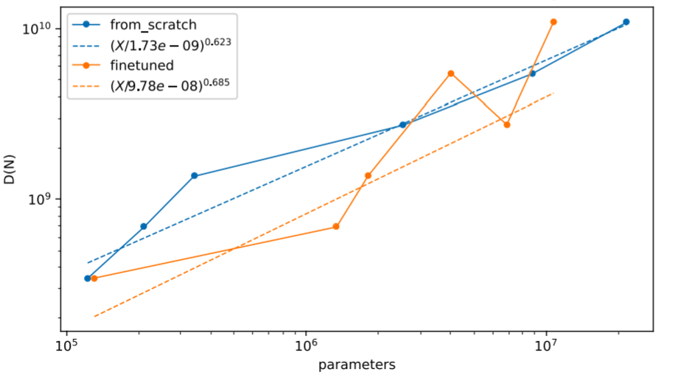
What exactly is a low-data regime?
Notation: D(N) - Amount of data it takes to reach 99% of the performance that infinite python data would yield for a given model size.
D / D(N) <= 0.10
LOW DATA REGIME

Slide 14
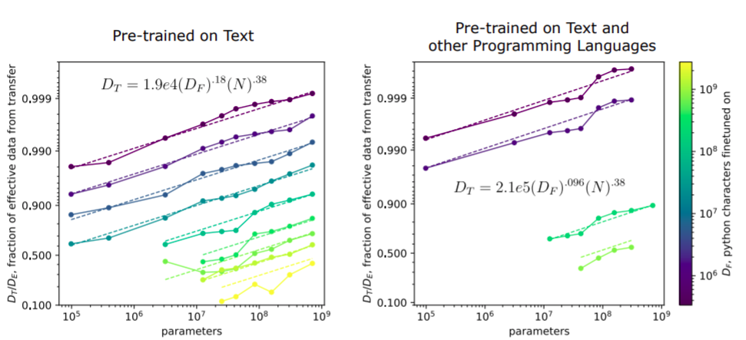
Experiment 1: Observations
The effective data transferred is well-described by a power-law in the low-data regime.
}
good fit for over 3 orders of magnitude in fine-tuning dataset size.
{
good fit for over 4 orders of magnitude in model size.

Slide 15
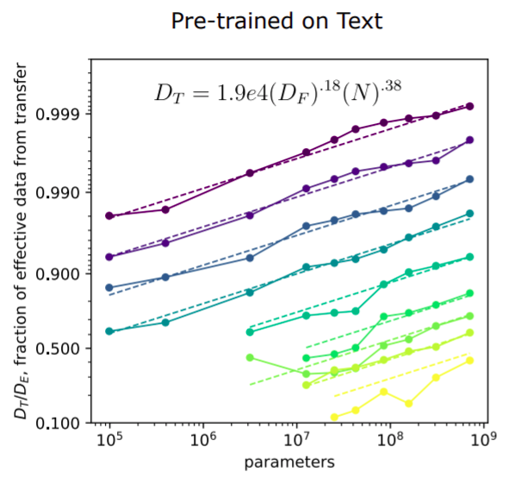
Experiment 1: Observations
The effective data transferred is well-described by a power-law in the low-data regime.
𝛃 ≈ 2α
10x increase in model size, N, equivalent to 100x increase in fine-tuning dataset size, D_{F}.

Slide 16
Experiment 1: Observations
2. Identical scaling with model size, the exponent β = 0.38
Appears to depend only on the target distribution

Slide 17
Experiment 1: Observations
3. Exponent α - Measure of the proximity of two distributions
Smaller α ⇒ closer proximity

Slide 18
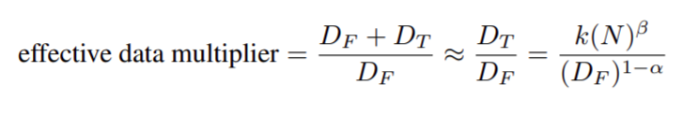
Experiment 1: Observations
4. Pre-training multiplies the fine-tuning dataset in the low-data regime.
D_{T} is approximately 1000x bigger than D_{F}

Slide 19
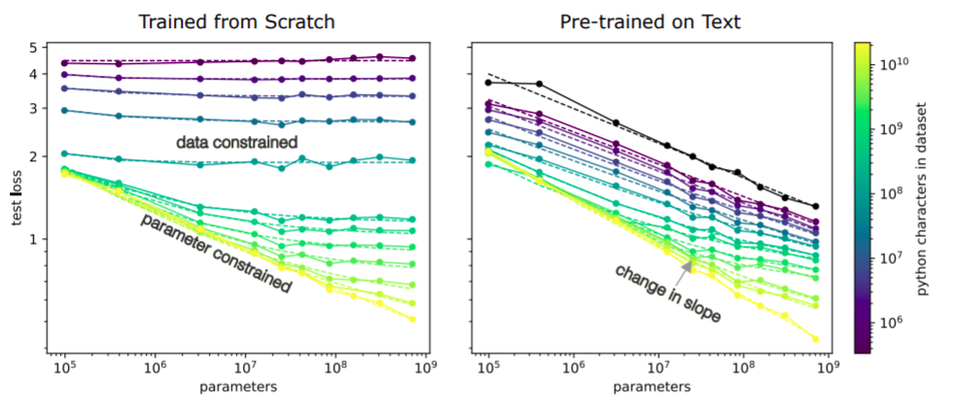
Experiment 1: Observations
5. When data limits performance, the pre-trained models have a better scaling law.
Zero-shot performance
Limited data and increasing model size
Steeper line with large dataset

Slide 20
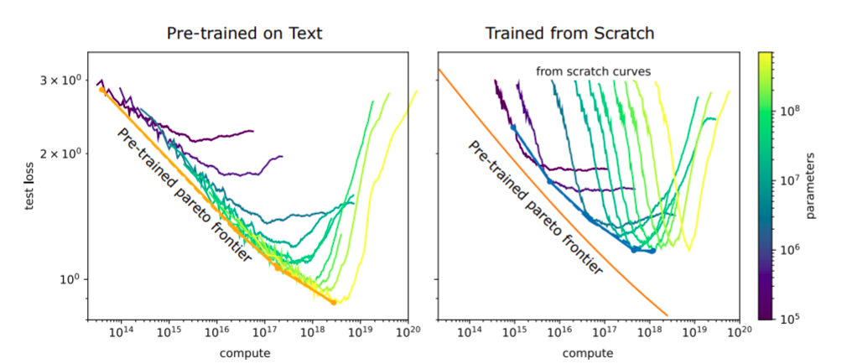
Experiment 1: Observations
6. Fine-tuned models are more compute efficient in the low data regime (ignoring pre-training).

Slide 21
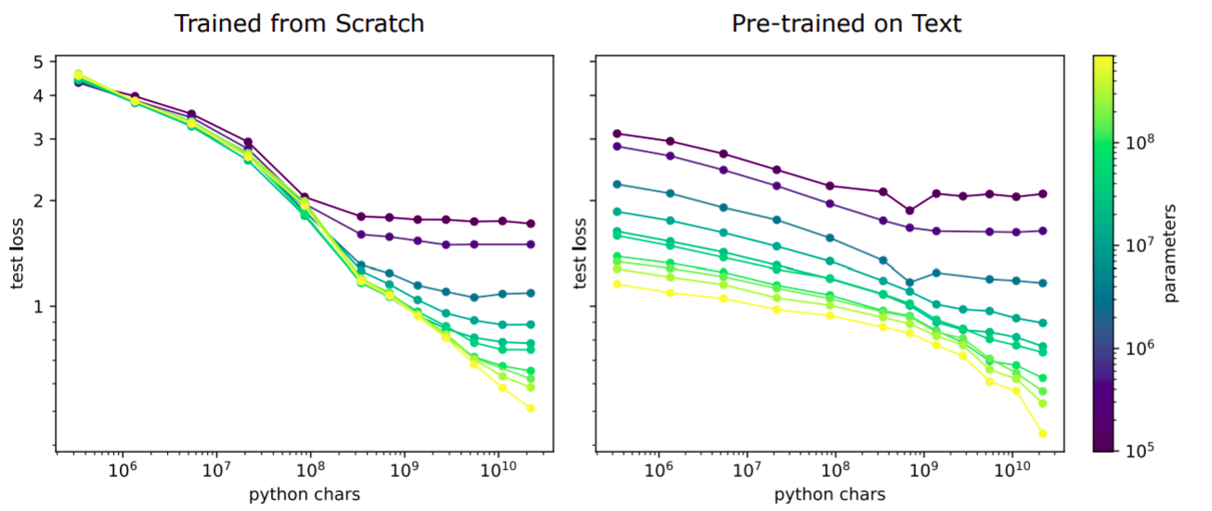
CAN PRE-TRAINING HARM PERFORMANCE?
Pretraining harms the model performance in high data regime
OSSIFICATION
Why does ossification occur?
For a 1M parameter model trained in high data regime (>1e8) ⇒ model trained from scratch performs better

Slide 22
Experiment 1: Discussion
1. Potential applications of these scaling laws
Whether to gather more data for fine-tuning?
Collecting more data is expensive
Use power law ⇒ cheap experiment to check

Slide 23
Experiment 1: Discussion
2. Distance between pretrained and fine-tuned distribution
Dissimilarity of English and Python is representative of transfer between distant distributions.
There is English within python code.
Closer distributions like English:French and farther distributions like English:Math - Interest for the future.

Slide 24
Experiment 1: Limitations
Models weren’t tuned for fine-tuning -> leveraged hyperparameters from “Scaling laws for Neural Language Models”.
Unclear if the power law fit would be observed for a broad set of distribution pairs.
Transfer between distributions was measured in an unsupervised setting.
Unclear as to what degree the findings would generalize to a supervised or RL setup.
Performance was only measured on transformers.

Slide 25
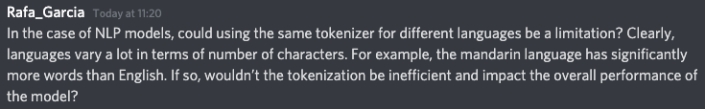
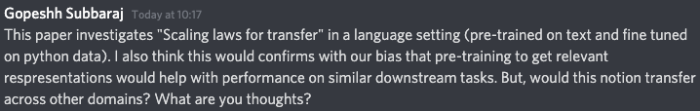
Yes! Its a limitation
It should
Potentially, yes!

Slide 26


English is used to communication of information between humans and Python is used to transfer instructions to a computer. So, their purpose is different.
You can get a good performance using a small finetuning dataset which is equivalent to training from scratch using a large dataset. Intuitively speaking, the target dataset has been multiplied.
It will be discussed in more detail soon, but the short answer is that the amount of effective transfer depends on linguistic similarity between the two languages (English and Chinese vs English and German).

Slide 27
Experiment 2: Transfer from English to other human languages
Another experiment which explores the scaling laws for transfer.
Explores and discusses scaling laws discovered while fine-tuning across different languages with pre-trained English language models.
Christina Kim- https://christina.kim/2021/04/11/scaling-laws-for-language-transfer-learning/

Slide 28
Experiment 2: Training setup
Dataset
OpenWebText2 was used to pretrain the model which is the open sourced version of WebText created by EleutherAI.
For German and Spanish, OSCAR (Open Super-large Crawled Aggregated coRpus) was used which is a multilingual corpus collected from Common Crawl.
For Chinese, Community QA was used (details not given).
Model
Transformer with non embedding parameters ranging from 3.3M to 124M.
Used GPT-2’s Byte level Byte Pair Encoding

Slide 29
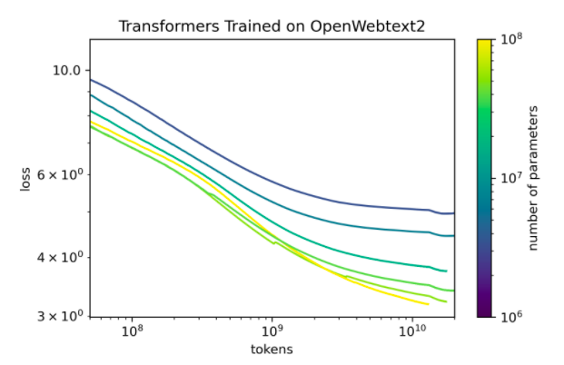
Experiment 2: Pretraining
The loss for the transformer trained on OpenWebText2 decrease as the number of tokens and model parameters increase
The decrease is not linear which is because the larger models were undertrained and hyperparameters were not tuned properly.

Slide 30
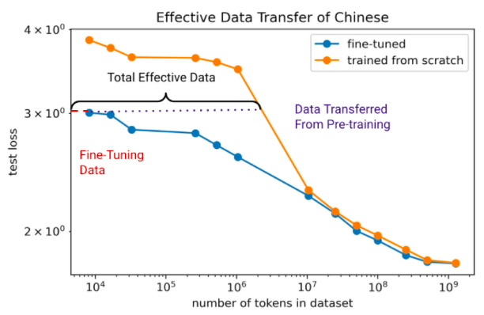
Experiment 2: Effective data transfer
Similar to original scaling laws paper, D_{T} (Effective Data Transferred) = D_{E}-D_{F}
The curves are not smooth/linear because larger models are undertrained.

Slide 31
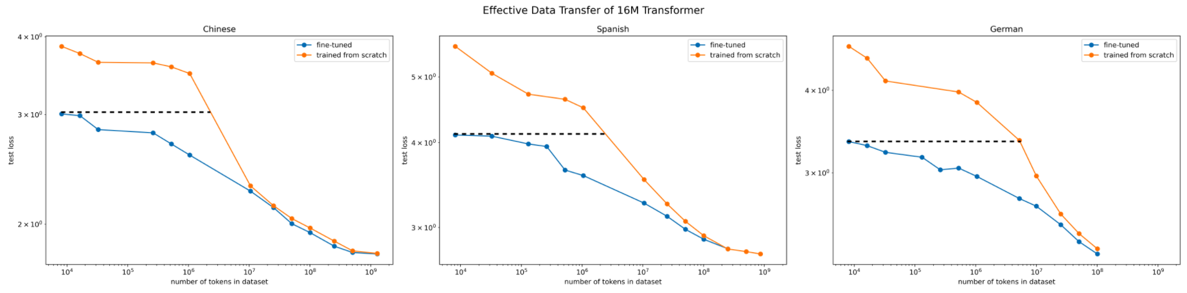
Experiment 2: Results
Effective data transfer from English to Chinese, Spanish and German.
Lowest Effective transfer for Chinese. Pretraining helps for one magnitude less(10⁷ vs 10⁸).
Highest Effective Transfer for German because of high linguistic similarity (Germanic Languages).
Less effective transfer for Spanish (Romance Language).

Slide 32
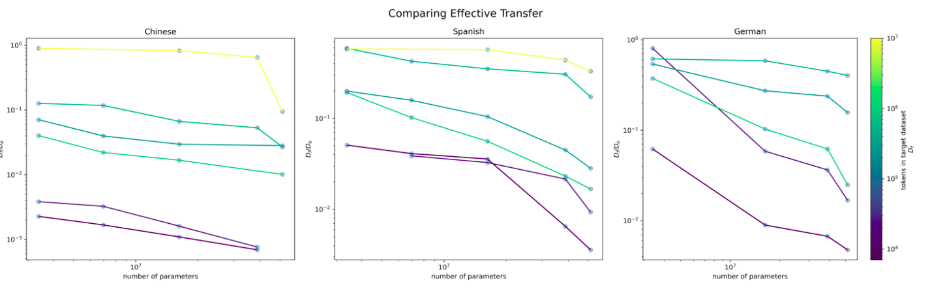
Experiment 2: Results
Small d_{f} / d_{e} is better.
d_{f}/d_{e} increases as finetuning dataset size increases.

Slide 33
Experiment 2: Results
d_{f}/d_{e} decreases as model size increases
Slopes of the curve for german is higher than other language due to higher effective transfer.
Some of the curves for spanish and german are inconsistent because the training is not done properly.

Slide 34
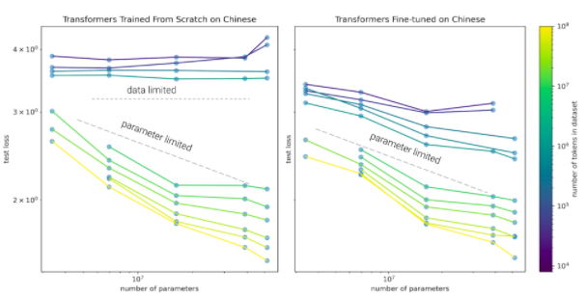
Experiment 2: Results
Similar to the results of the previous experiment.
Model trained from scratch on low data regime is data limited, not the case for finetuned model.
In high data regime, both curves are similar.

Slide 35
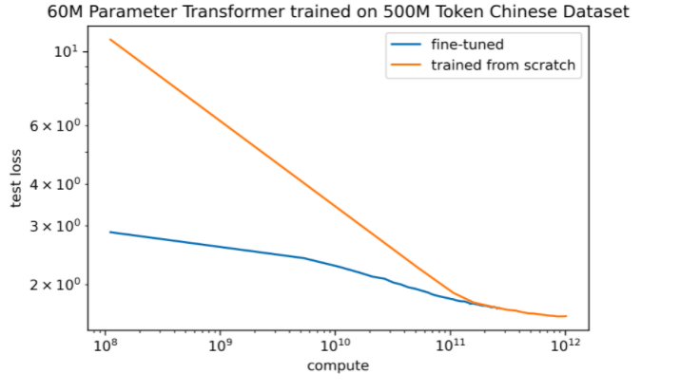
Experiment 2: Results
Finetuned model is more compute efficient in low compute regime.

Slide 36
Experiment 2: Limitations and Future Works
Limitations
Same tokenizer used for all languages. Most problematic for Chinese.
Larger models are undertrained.
Better hyperparameter tuning can be performed.
Future Works
Finetuning the models for low resource languages.
Finding the scaling law equations and comparing those for different languages.
Finding a good ratio for finetuning and pretraining for different languages for a given budget.

Slide 37
Conclusion
Scaling Laws for transfer have been studied for transfer from English Language to Python code and English Language to Different Languages.
Linguistic Similarity had a huge impact in language transfer. Hence, it is necessary to make sure that the source and target datasets have some amount of similarity.
It will be interesting to see results for transfer in different domains like image and video.

